Slide 1
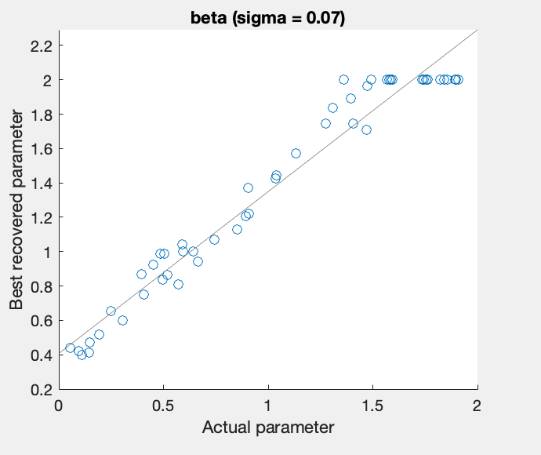
Only beta free and recovered (all fixed but for different levels of sigma)
Recovery better when sigma = 0.07
Recovery worse when sigma = 0.02

Slide 2
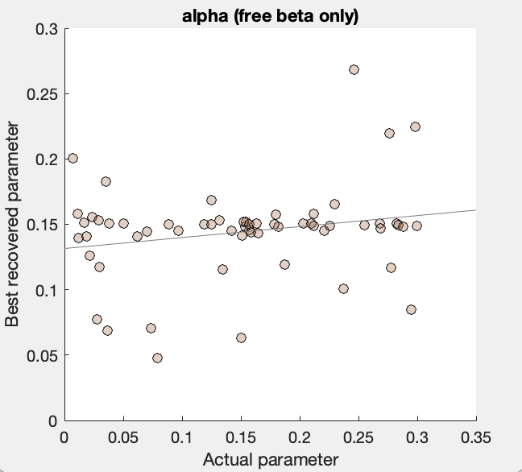
Alpha and beta free and recovered

Slide 3
Alpha, beta, kappa free and recovered
(high sigma = 0.07)

Slide 4
Alpha, beta, kappa free and recovered
(low sigma = 0.02)

Slide 5
All free and recovered
(high sigma range)

Slide 6
All free and recovered
(low sigma range)

Slide 7
No integration over observations +
No anti-sigmoid transformation

Slide 15
Integration over observations +
No anti-sigmoid transformation

